Slide 1

Student Management System
Laravel Notes - Hafeez
www.codehafeez.com

Slide 2
Create Folder & Remove Public Folder Dir.

Slide 3
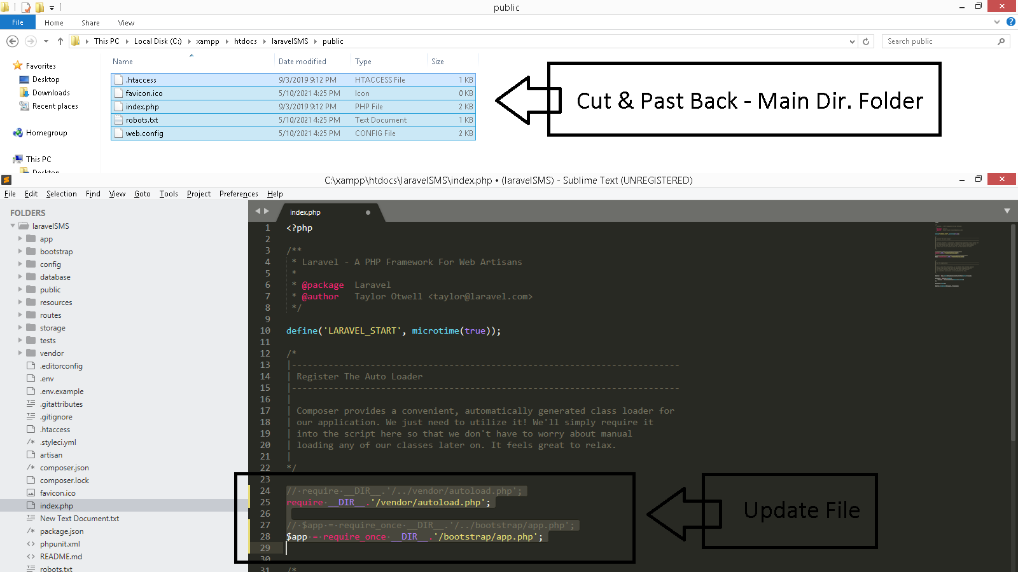
composer create-project laravel/laravel student_system_laravel

Slide 4
Create Page

Slide 5
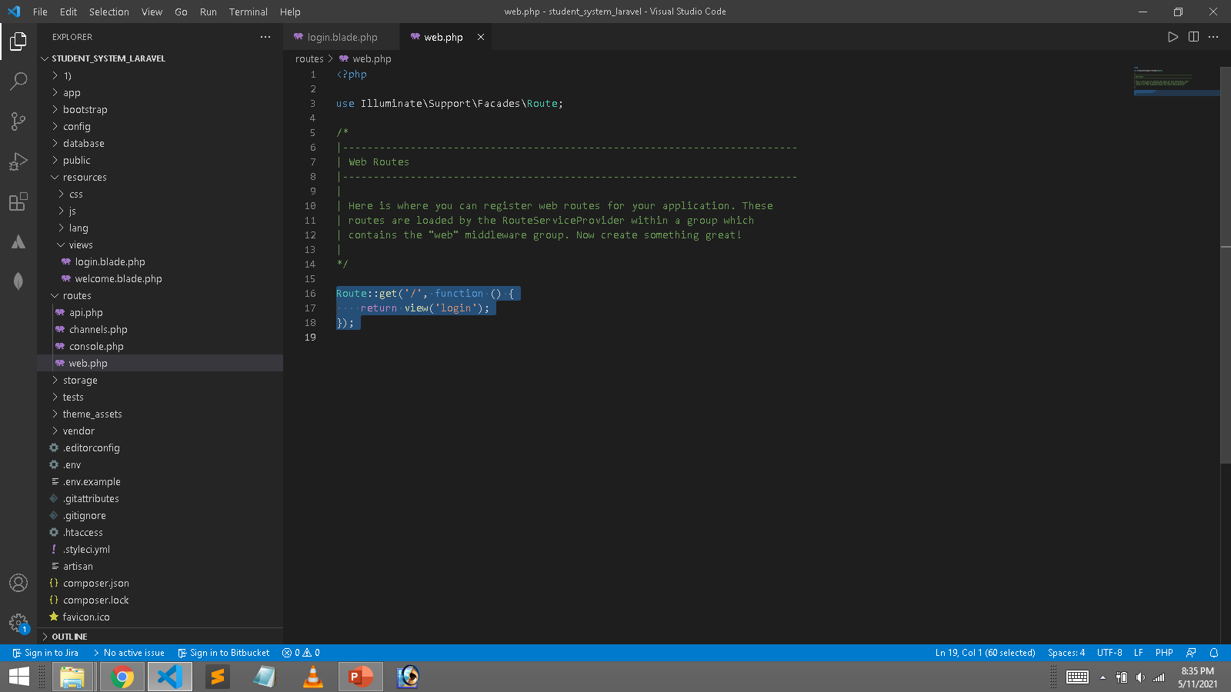
Set Default Page

Slide 6
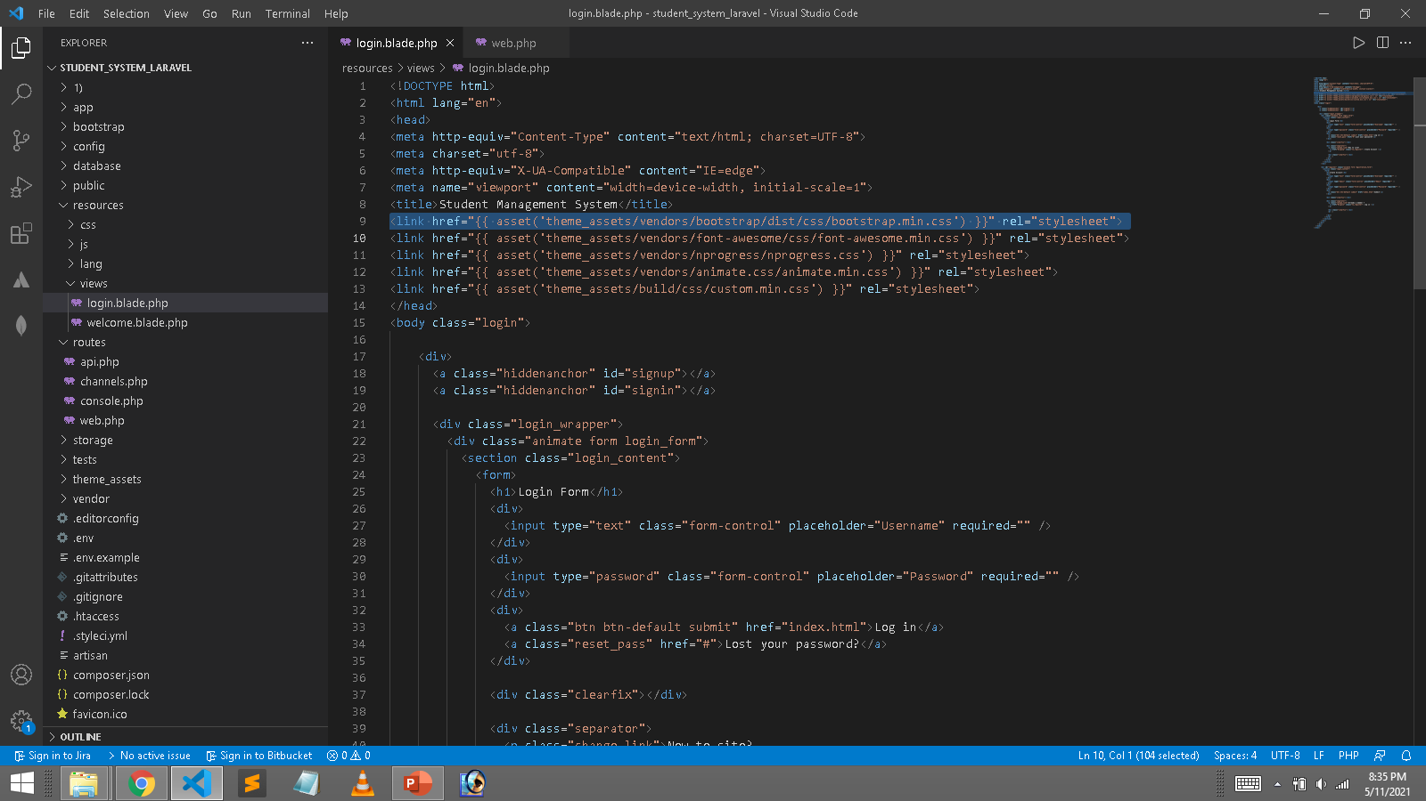
Create Page
<link href="{{ asset('theme_assets/vendors/bootstrap/dist/css/bootstrap.min.css') }}" rel="stylesheet">

Slide 7
Controller & Model
php artisan make:controller AdminController
// create model simple
php artisan make:model AdminModel
// create model with migration
php artisan make:model AdminModel –migration
// create model with migration
php artisan make:model StudentModel --migration
// Run this command to auto create table
php artisan migrate

Slide 8
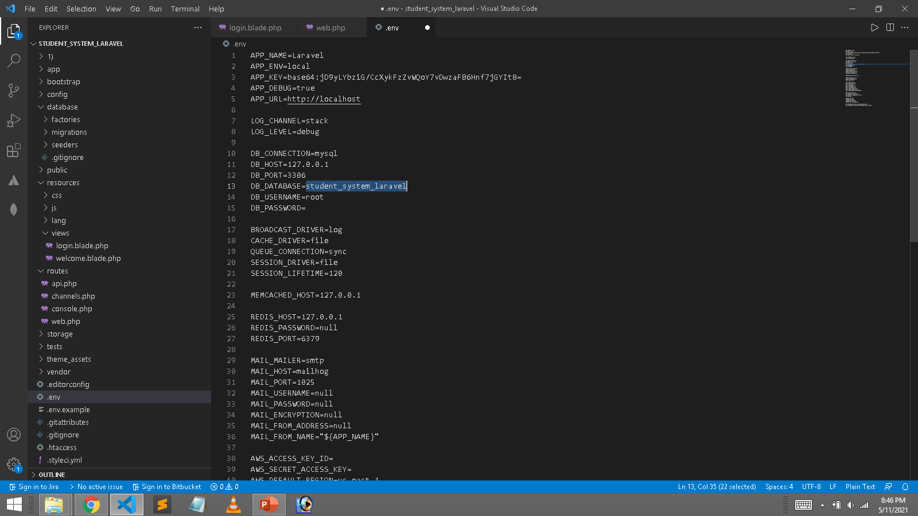
Set Database Name

Slide 9
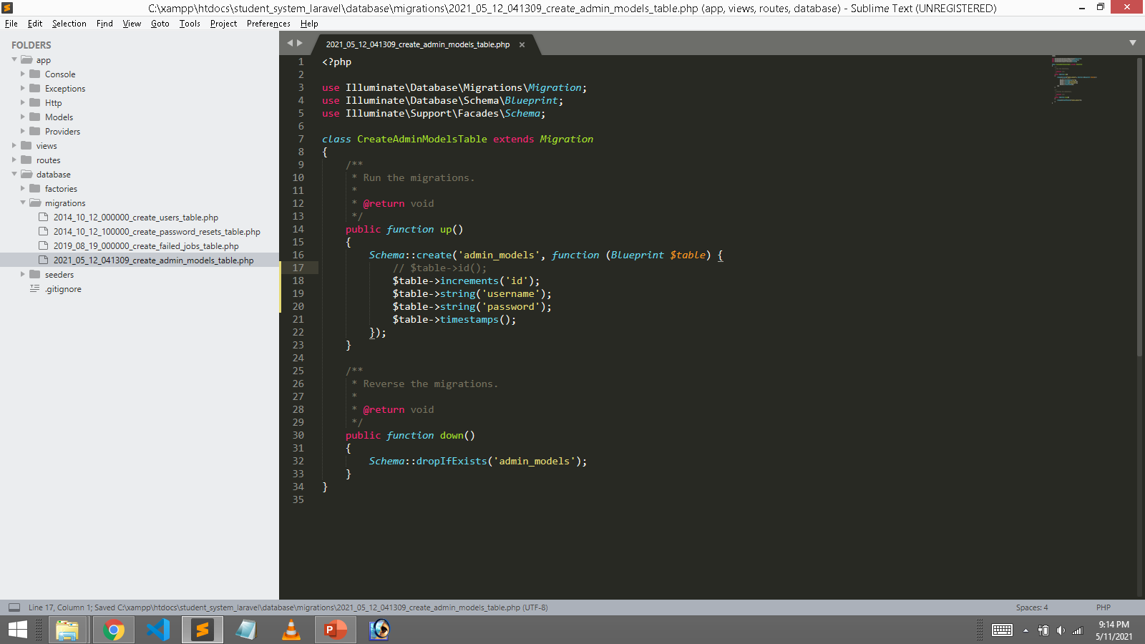
// $table->id();
$table->increments('id');
$table->string('username');
$table->string('password');
$table->timestamps();
// Run this command to auto create table
php artisan migrate

